Slide 1
Deep Potential Molecular Dynamics: A Scalable Model with the Accuracy of Quantum Mechanics
Computational Chemical Science Center: Chemistry in Solution and at Interfaces
Ryan Szukalo
August 13, 2025

Slide 2

The Central Problem Being Addressed: Accuracy vs. Efficiency Dilemma
Ab Initio MD (AIMD)
Quantum Mechanical Accuracy (DFT)
Computationally Expensive (~100 atoms, ~100ps)
Scales as O(N³) with system size
Empirical Force Fields
Computationally Efficient
Limited Accuracy (and Transferability)
Ad hoc functional forms
Research Question Here
Can we achieve quantum mechanical accuracy at classical force field cost, while preserving symmetries naturally?

Slide 3
Where was the Field at this Time?
Limited methods available, the uptick in machine learning potentials was just starting
Behler-Parrinello Neural Networks
Uses symmetry functions (2-, 3-body) as descriptors
These function forms were largely ad hoc
Difficult to extend to multiple atomic species
Gradient-Domain Machine Learning
Uses Coulomb Matrix eigenvalues
Limited to small molecules
Challenges with periodic systems

Slide 4
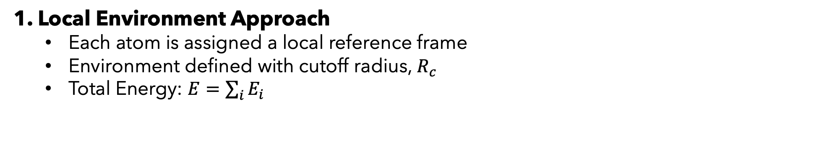
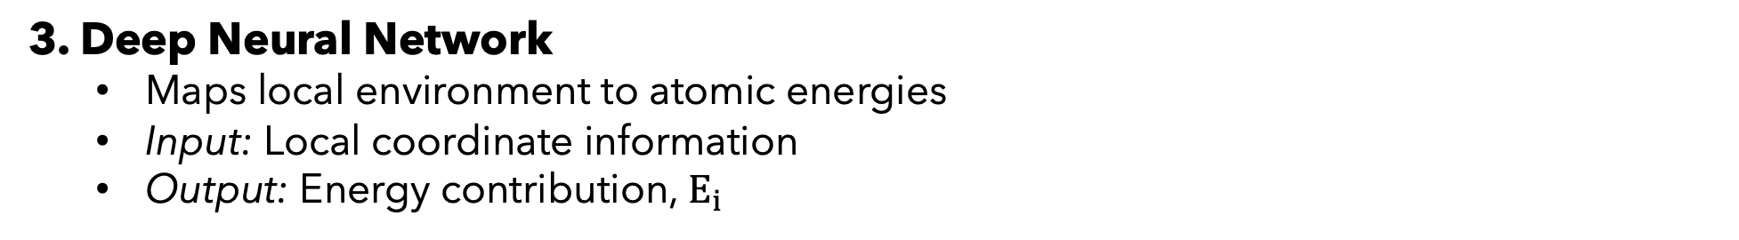
DPMD Core Methodology
1. Local Environment Approach
Each atom is assigned a local reference frame
Environment defined with cutoff radius, $R_{c}$
Total Energy: $E=\sum_{i}{E_{i}}$
2. Symmetry Preservation
Translational: Use relative coordinates
Rotational: Local reference frames
Permutational: Systematic atom sorting
3. Deep Neural Network
Maps local environment to atomic energies
Input: Local coordinate information
Output: Energy contribution, $E_{i}$

Slide 5
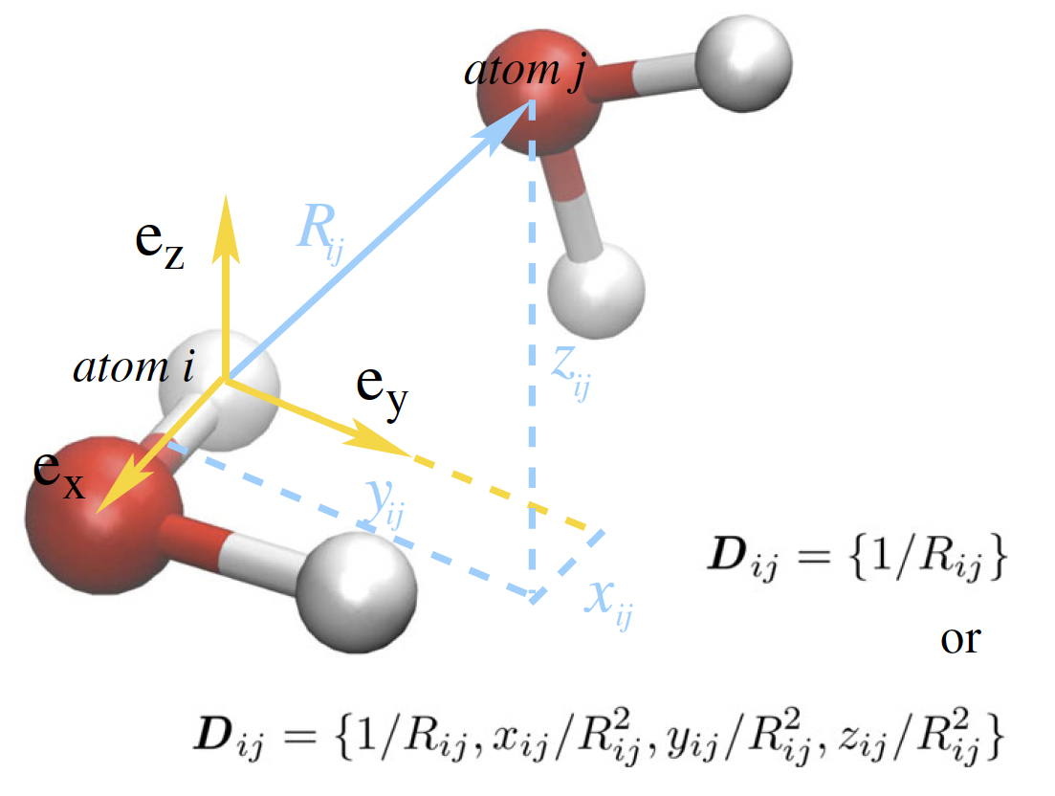
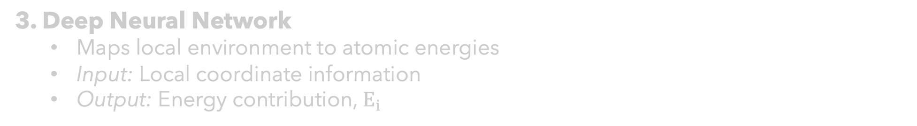
DPMD Core Methodology
1. Local Environment Approach
Each atom is assigned a local reference frame
Environment defined with cutoff radius, $R_{c}$
Total Energy: $E=\sum_{i}{E_{i}}$
2. Symmetry Preservation
Translational: Use relative coordinates
Rotational: Local reference frames
Permutational: Systematic atom sorting
3. Deep Neural Network
Maps local environment to atomic energies
Input: Local coordinate information
Output: Energy contribution, $E_{i}$

Slide 6
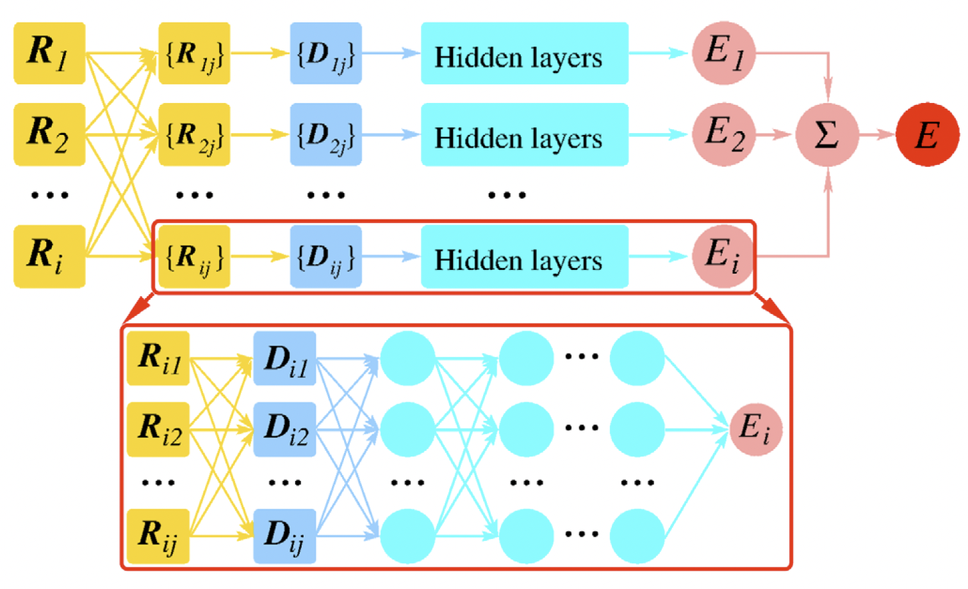

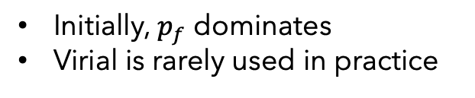
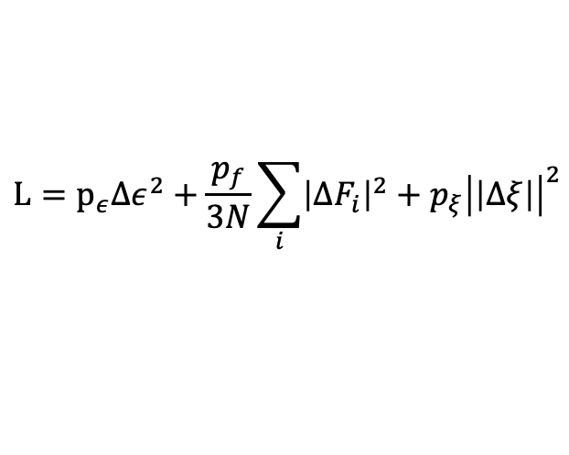
DPMD Core Methodology
1. Local Environment Approach
Each atom is assigned a local reference frame
Environment defined with cutoff radius, $R_{c}$
Total Energy: $E=\sum_{i}{E_{i}}$
2. Symmetry Preservation
Translational: Use relative coordinates
Rotational: Local reference frames
Permutational: Systematic atom sorting
3. Deep Neural Network
Maps local environment to atomic energies
Input: Local coordinate information
Output: Energy contribution, $E_{i}$
Loss Function
$$L=p_{ε}Δε^{2}+\frac{p_{f}}{3N}\sum_{i}{{\left|ΔF_{i}\right|}^{2}+p_{ξ}{\left|\left|Δξ\right|\right|}^{2}}$$
Initially, $p_{f}$ dominates
Virial is rarely used in practice

Slide 7
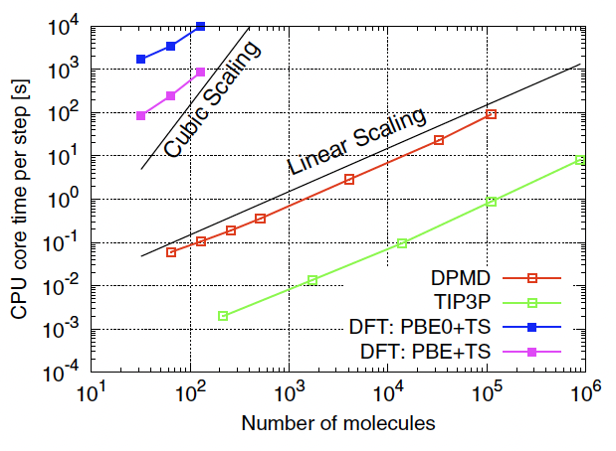
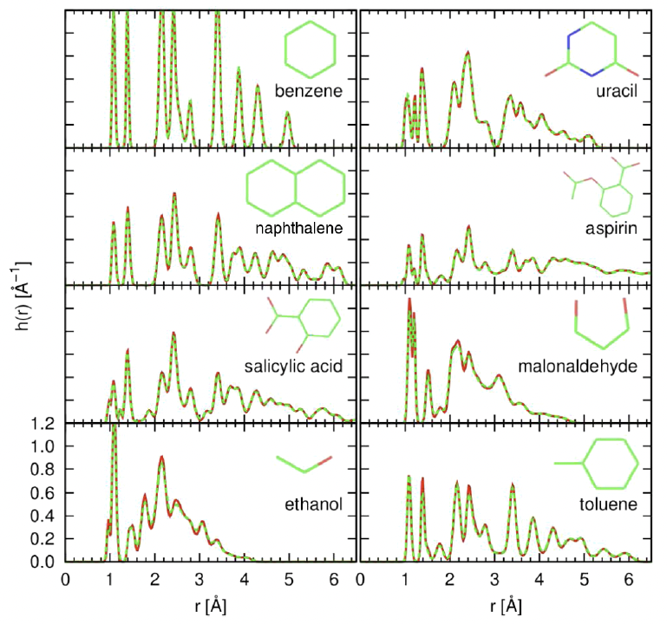
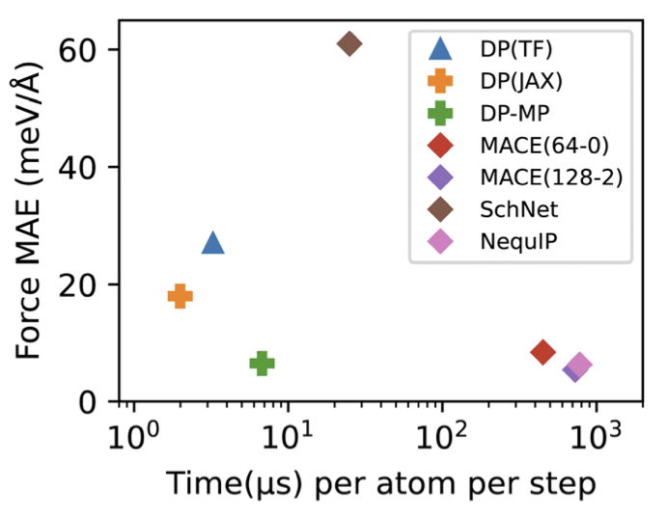
Key Results
Computational Efficiency
General System Accuracy
Gao, R., Li, Y., & Car, R. (2024). Physical Chemistry Chemical Physics, 26(35), 23080-23088.

Slide 8

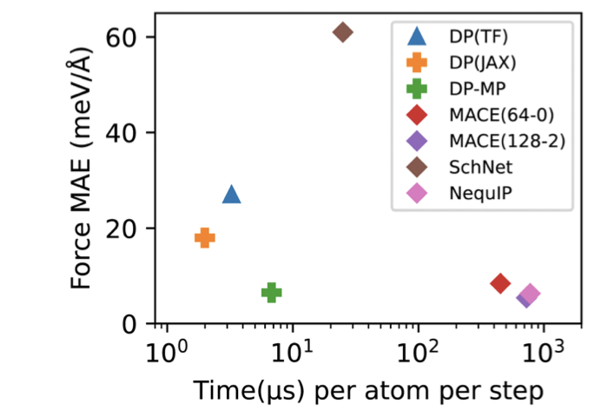
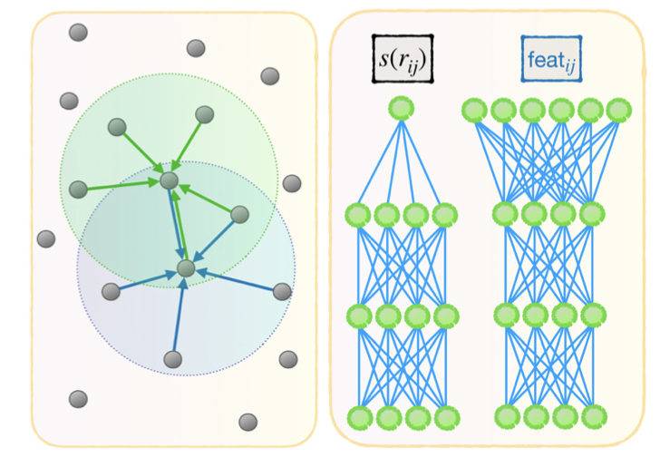
`
The Deep Potential Kit
2018
2020
2022
2023
2024
DP-GEN
DP-LR
DP-MP
V2
Zhang, L., Han, J., Wang, H., Car, R., & E, W. (2018). Deep potential molecular dynamics: a scalable model with the accuracy of quantum mechanics. Physical review letters, 120(14), 143001.
Zhang, Y., Wang, H., Chen, W., Zeng, J., Zhang, L., Wang, H., & Weinan, E. (2020). DP-GEN: A concurrent learning platform for the generation of reliable deep learning based potential energy models. Computer Physics Communications, 253, 107206.
Zhang, L., Wang, H., Muniz, M. C., Panagiotopoulos, A. Z., & Car, R. (2022). A deep potential model with long-range electrostatic interactions. The Journal of Chemical Physics, 156(12).
Zeng, J., Zhang, D., Lu, D., Mo, P., Li, Z., Chen, Y., ... & Wang, H. (2023). DeePMD-kit v2: A software package for deep potential models. The Journal of Chemical Physics, 159(5).
Gao, R., Li, Y., & Car, R. (2024). Enhanced Deep Potential Model for Fast and Accurate Molecular Dynamics; Application to the Hydrated Electron. Phys. Chem. Chem. Phys. 35(1)
Wang, H., Zhang, L., Han, J., & Weinan, E. (2018). DeePMD-kit: A deep learning package for many-body potential energy representation and molecular dynamics. Computer Physics Communications, 228, 178-184.

Slide 9
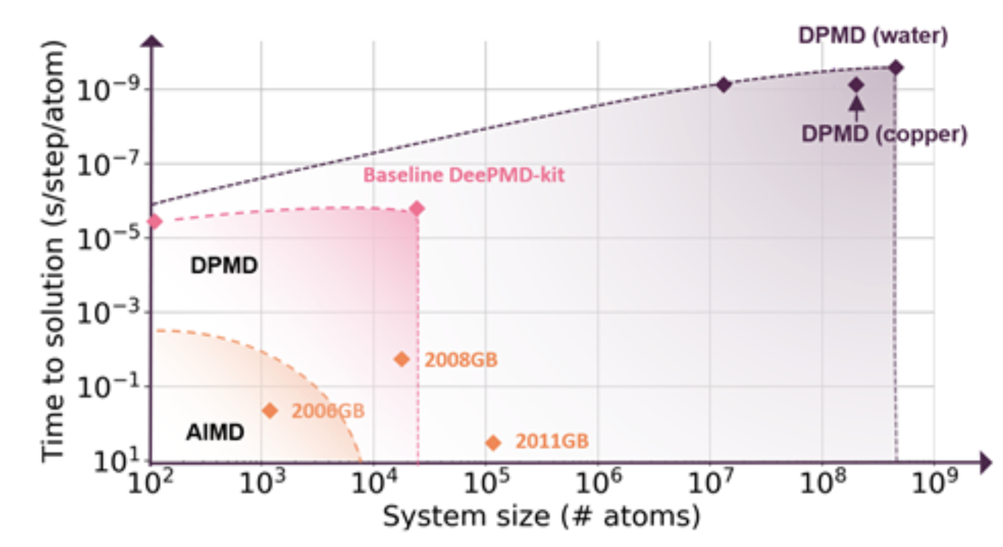
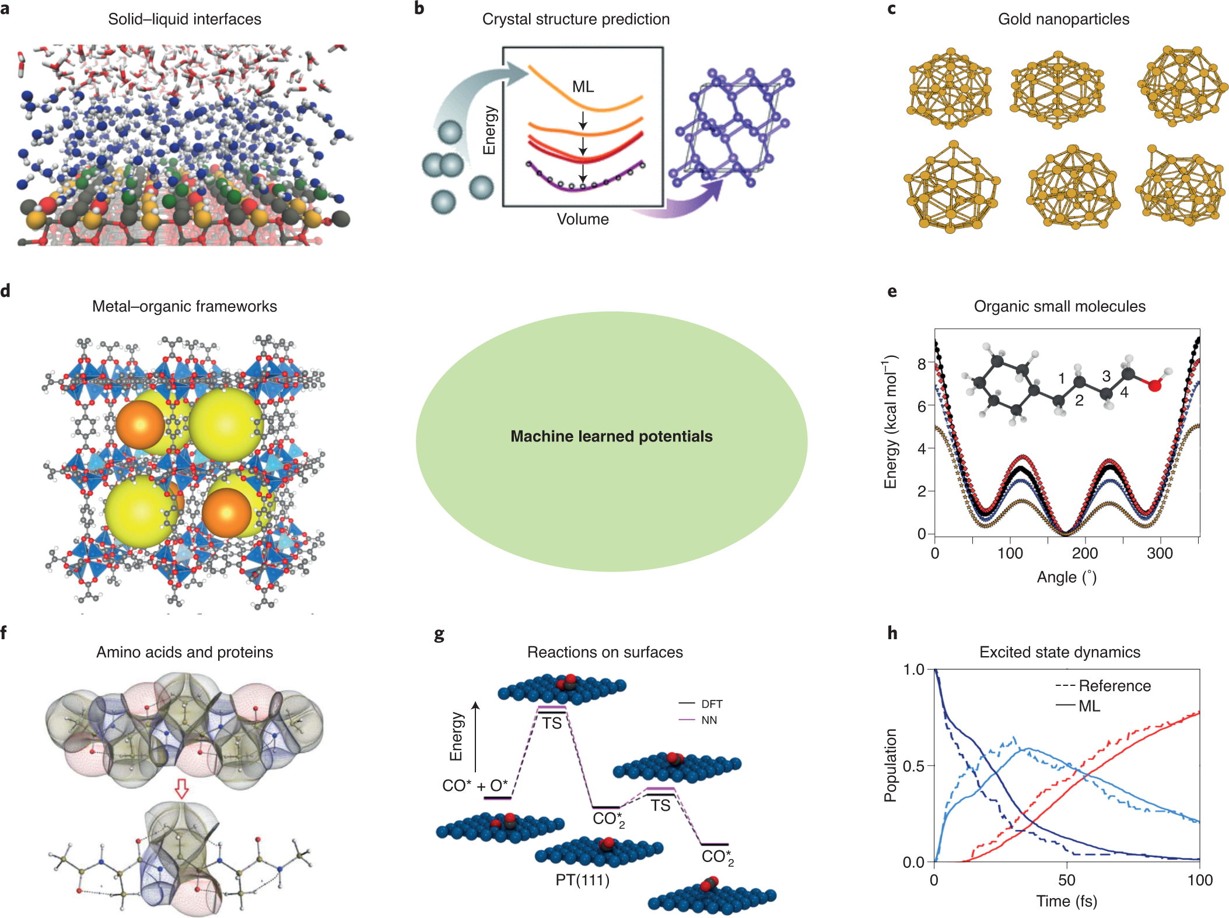
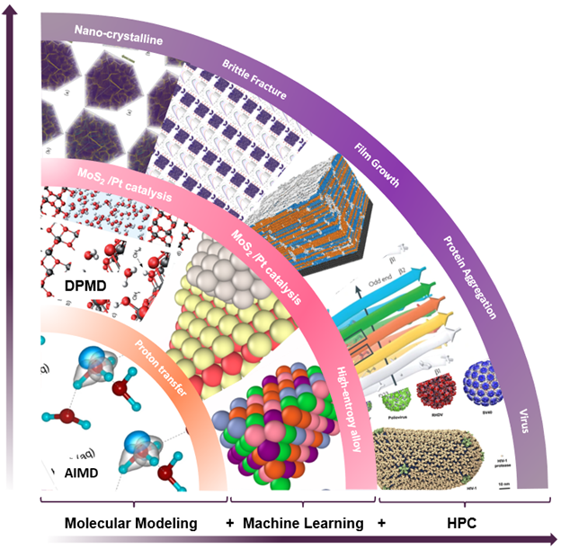
`
Applications of Machine Learned Potentials: DP-kit

Slide 10
`
Connecting this to the Code
Main Github: https://github.com/deepmodeling
Many ways to compile/install – Github binaries are easiest
CSI Tutorials: https://github.com/CSIprinceton/workshop-july-2023
Provides information to train your first model (with training data)
Demonstrates the need for active learning/enhanced sampling techniques
Demonstrates how DPMD does error/uncertainty quantification
Introduces how DP can treat long range interactions
DP-JAX: https://github.com/SparkyTruck/deepmd-jax
Main Github Repo has a LOT of code, difficult to follow
This python-JAX implementation is much easier to digest (and develop)

